Slide 1
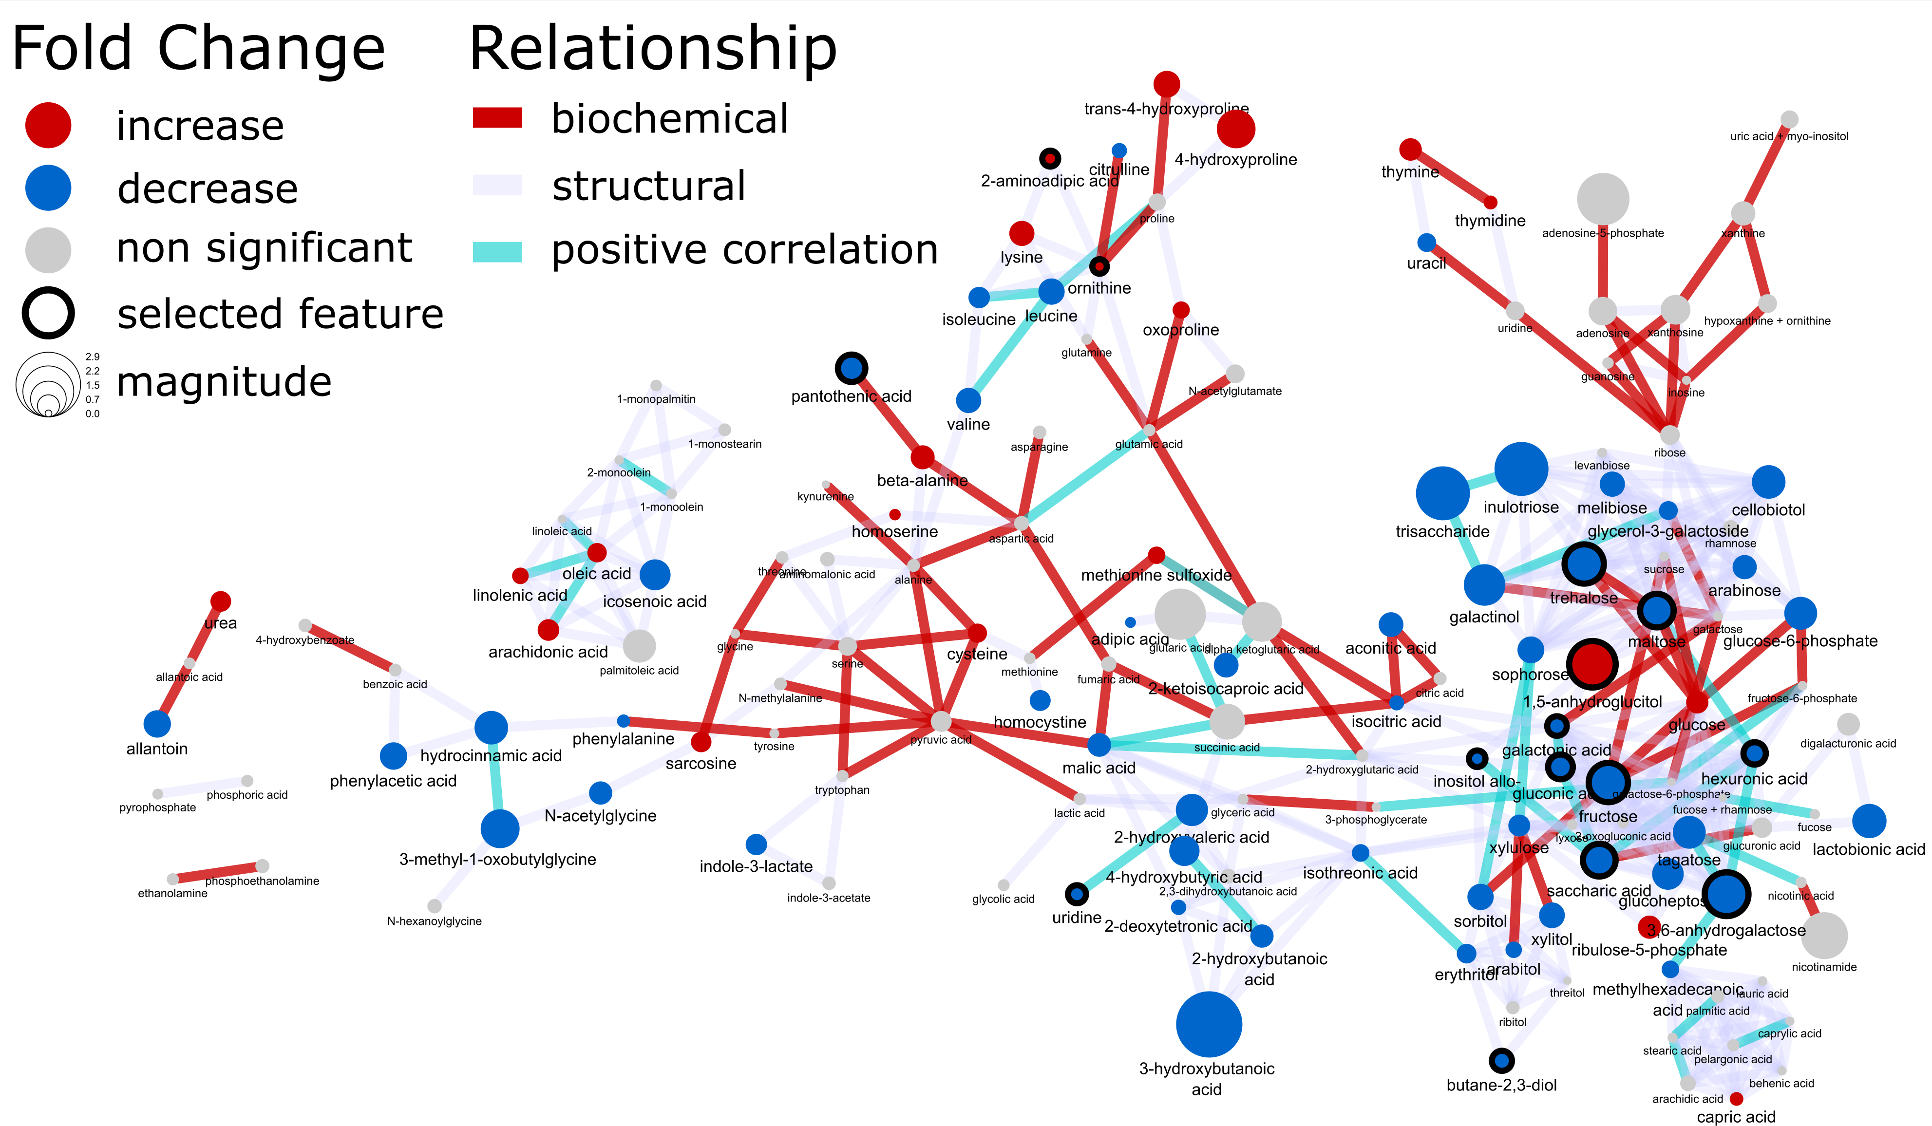
Welcome to network mapping 101
In the following course you will learn how to integrate statistical, multivariate and machine learning results within a publication quality biochemical network.

Slide 2
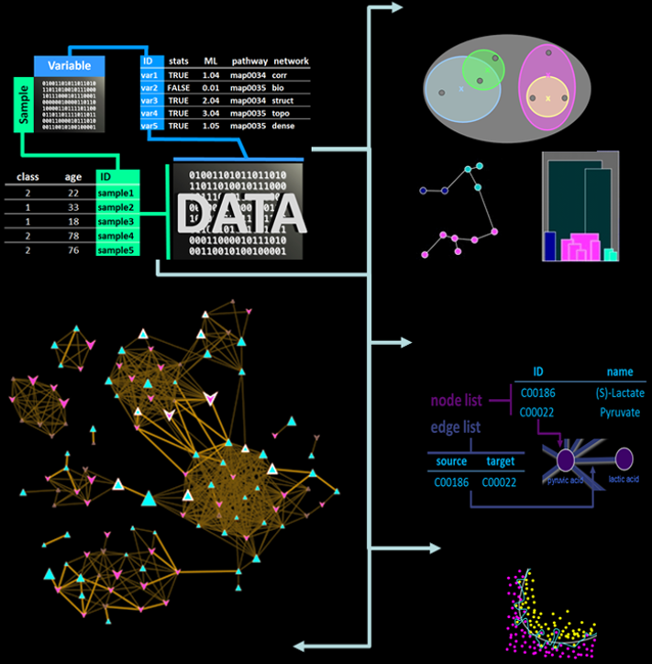
Tutorials
Preparing raw data for analysis
Statistical analysis
Multivariate data exploration
Supervised clustering
Machine learning
classification
model validation
feature selection
Network analysis
biochemical
structural similarity
correlation
Network mapping – putting it all together
https://creativedatasolutions.github.io/CDS.courses/courses/network_mapping_101/docs/#topics

Slide 3
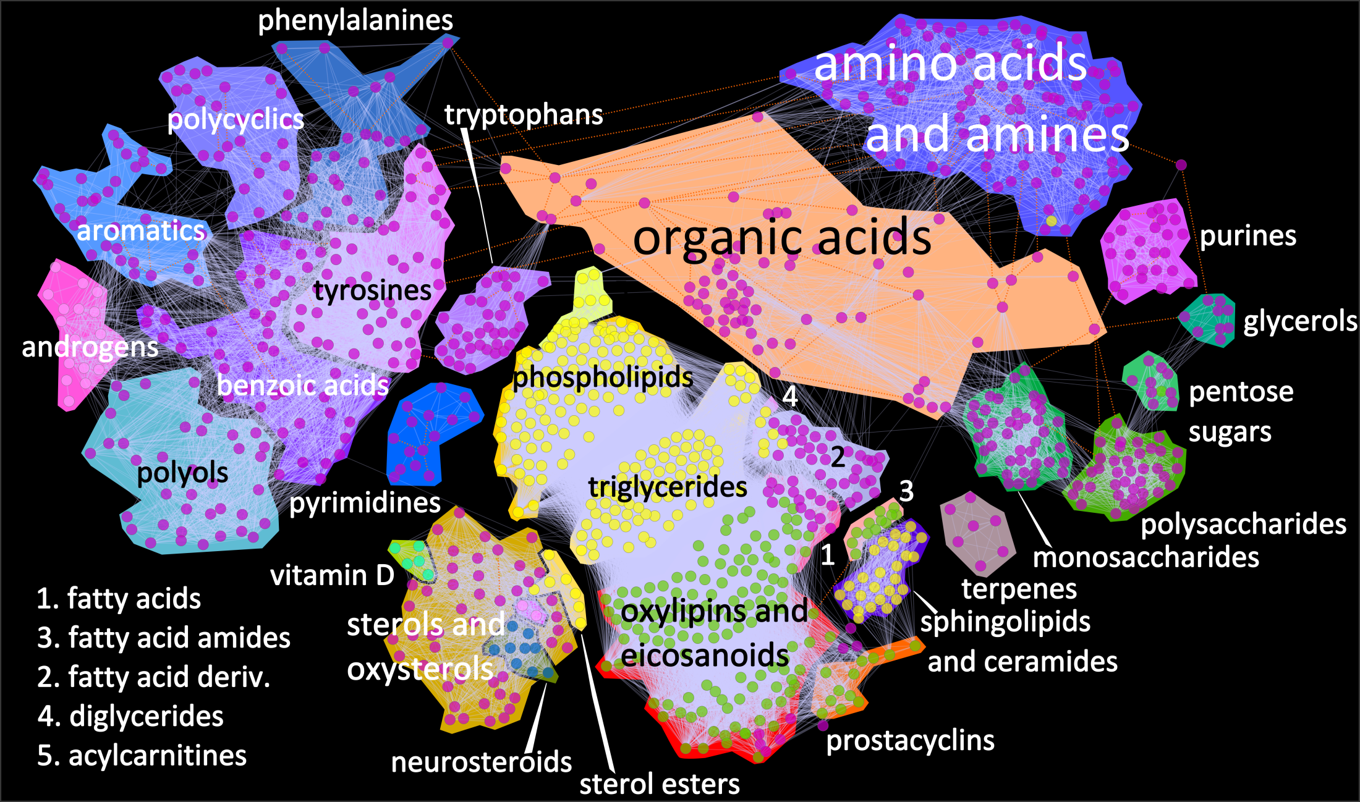
Analysis at the metabolomic scale

Slide 4
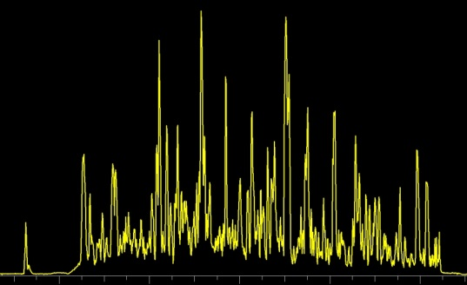
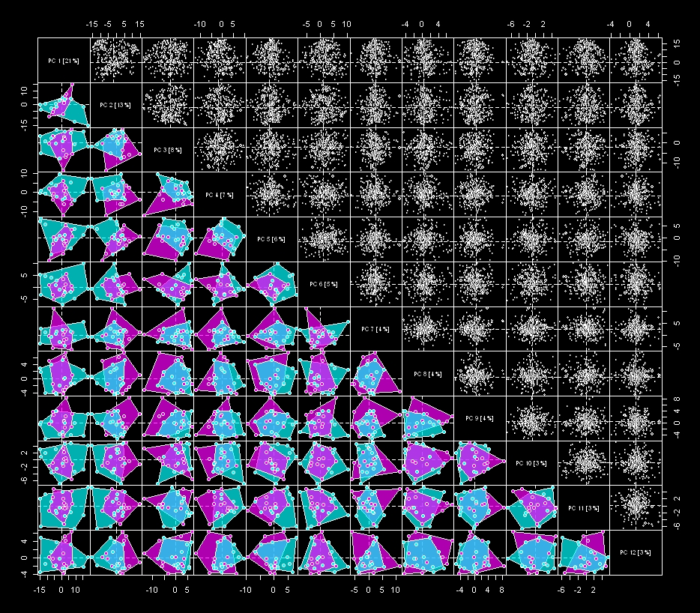
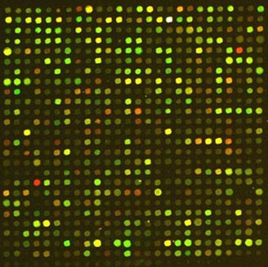
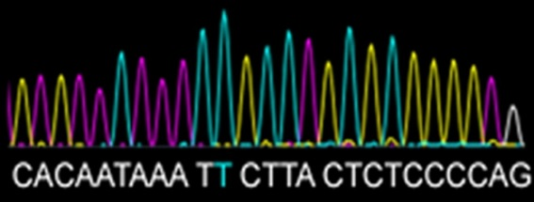
Integrate high-dimensional data
variables
Samples

Slide 5



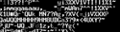
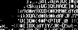
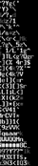
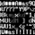
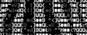

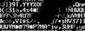


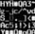

Identify what matters
Univariate
Multivariate
Predictive Modeling
Group 1
Group 2
ANOVA
PCA
PLS

Slide 6
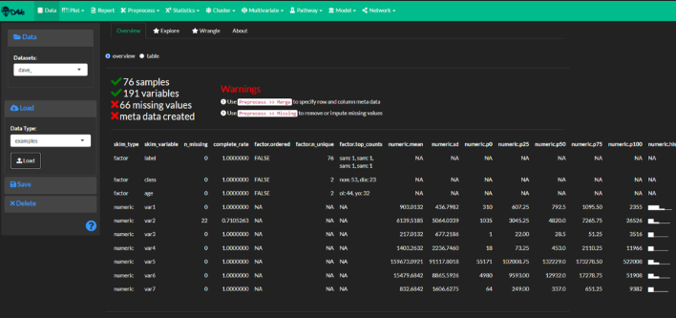
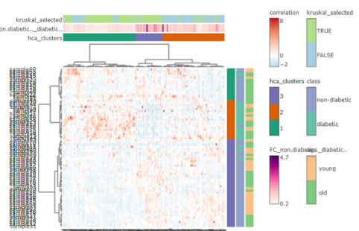
Topics
Data preparation
Differential expression
Hierarchical Clustering
Principal Components Analysis (PCA)
Statistical analysis
Machine learning
Network analysis
Network mapping
https://creativedatasolutions.github.io/CDS.courses/courses/network_mapping_101/docs/#topics

Slide 7
How to think about data complexity
variables
Experimental Design =
Meta Data
m
complexity
n
samples
Data
1-D
2-D
m-D
Variable # = dimensionality

Slide 8
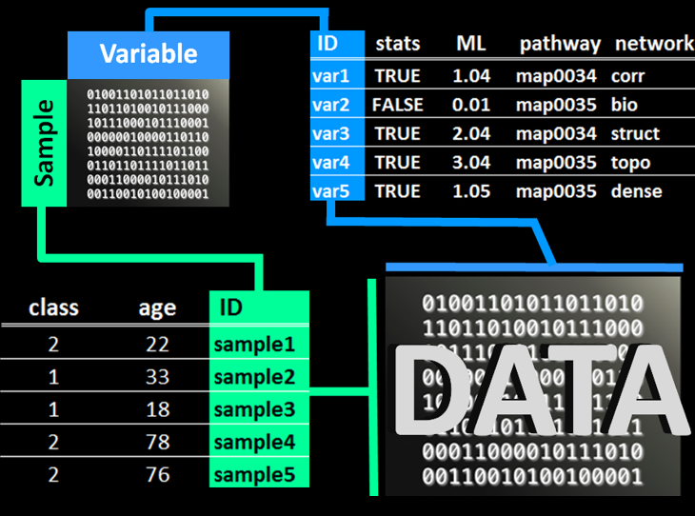
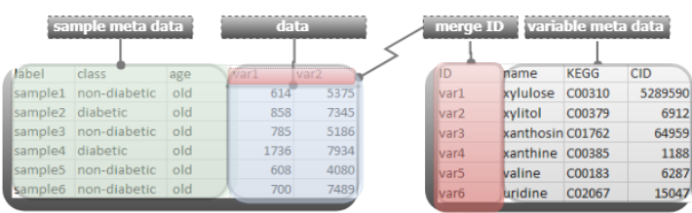
Data preprocessing
define
data
row meta data
column meta data
remove and/or impute
missing values
https://creativedatasolutions.github.io/CDS.courses/courses/network_mapping_101/docs/partial/preprocess/

Slide 9
Your turn
Follow along with the following tutorial:
https://creativedatasolutions.github.io/CDS.courses/courses/network_mapping_101/docs/partial/preprocess/

Slide 10
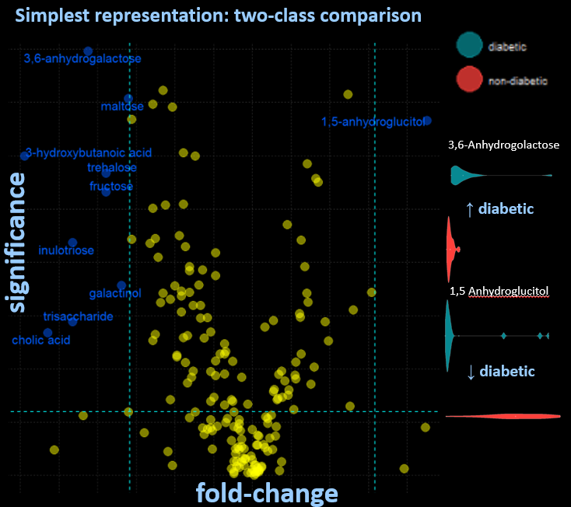
Differential expression
compare
class means
identify
significant differences
visualize
volcano plots
violin plots
https://creativedatasolutions.github.io/CDS.courses/courses/network_mapping_101/docs/partial/statistics/

Slide 11
Your turn
Follow along with the following tutorial:
https://creativedatasolutions.github.io/CDS.courses/courses/network_mapping_101/docs/partial/statistics/

Slide 12
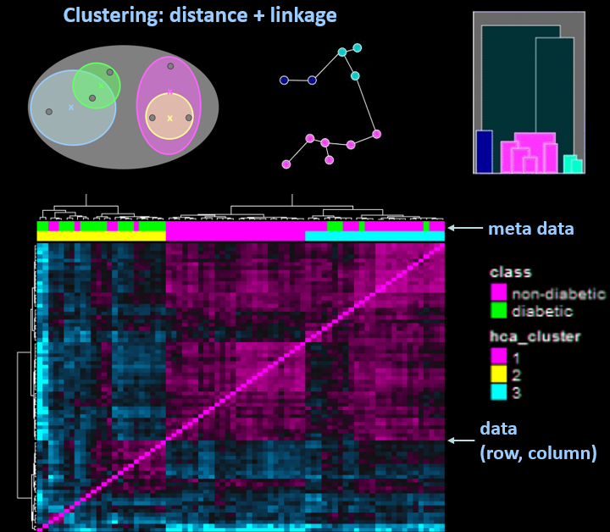
Hierarchical clustering (HCA)
group
samples and/or variables
define similarity
correlation
distance
linkage
visualize
heatmaps
dendrograms
https://creativedatasolutions.github.io/CDS.courses/courses/network_mapping_101/docs/partial/clustering/#heirarchical-clustering

Slide 13
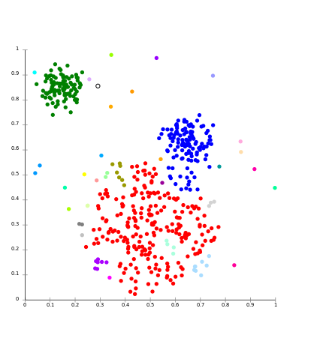
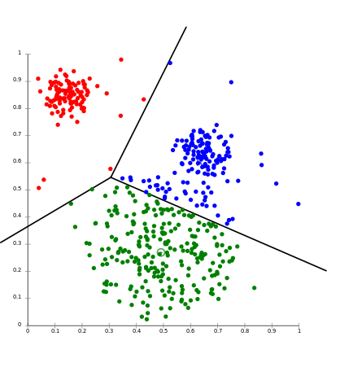
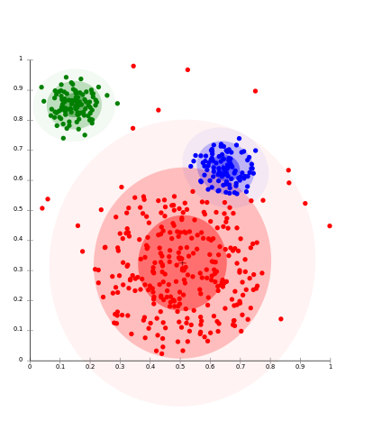
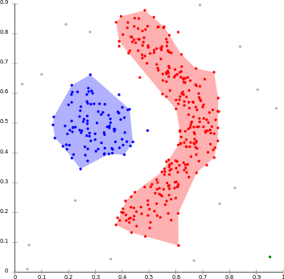
Clustering basics
Use the concept similarity/dissimilarity to group a collection of samples or variables
approaches
hierarchical (linkage)
non-hierarchical (k-NN, k-means)
distribution (mixtures models)
density (DBSCAN)
self organizing maps (SOM)
Linkage
k-means
Distribution
Density

Slide 14

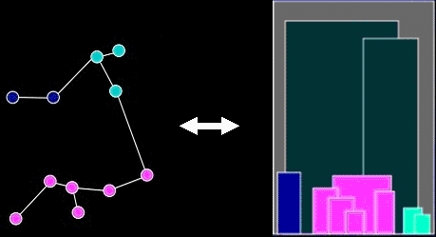
HCA goals
identify
patterns
group structure
relationships
evaluate and refine hypothesis
reduce complexity
Artist: Chuck Close

Slide 15
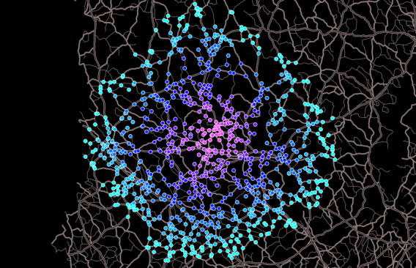
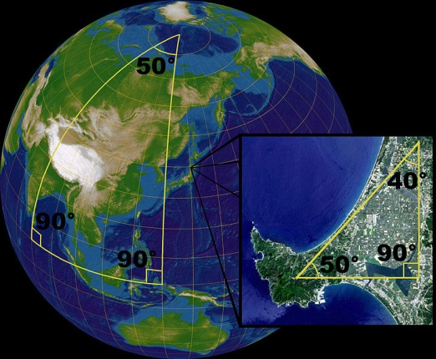
HCA methods
distance
defines “nearness” or similarity
Euclidean
Manhattan
Mahalanobis
non-Euclidean
X
X
X
*
Y
Y
Y

Slide 16
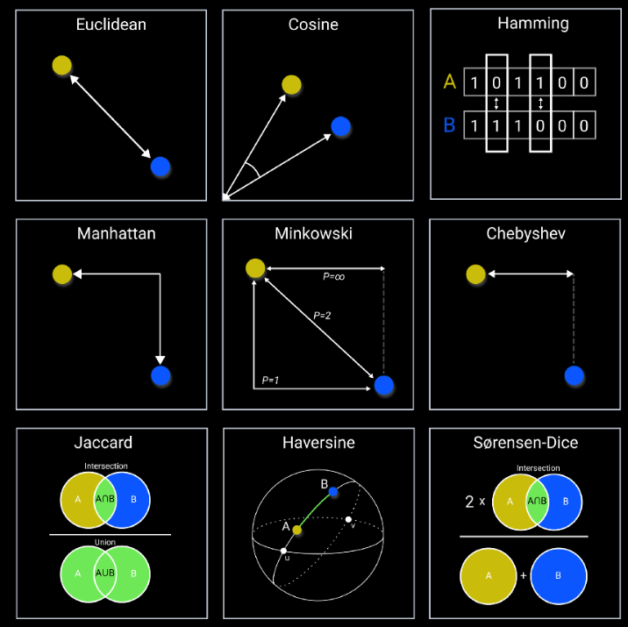
HCA methods
distance
defines “nearness” or similarity
https://towardsdatascience.com/9-distance-measures-in-data-science-918109d069fa

Slide 17
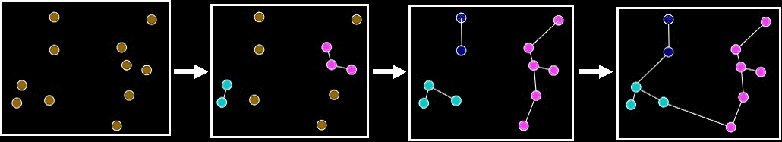
HCA methods
linkage or agglomeration
how samples or variables are connected or grouped
single
complete
centroid
average

Slide 18
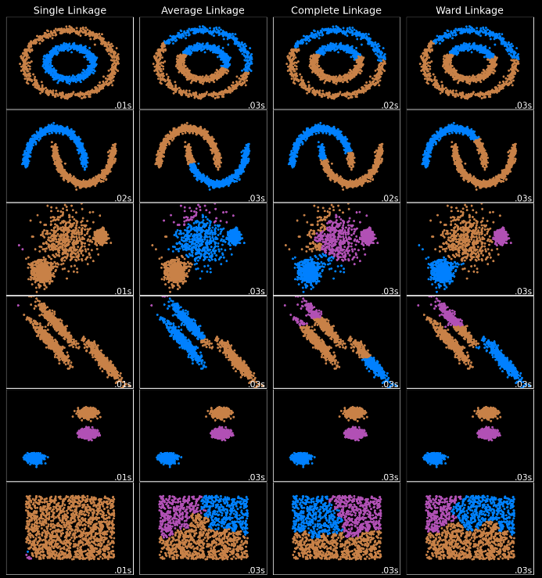
HCA methods
linkage or agglomeration
https://scikit-learn.org/stable/auto_examples/cluster/plot_linkage_comparison.html

Slide 19
HCA process
x
x
x
x
Similarity

Slide 20
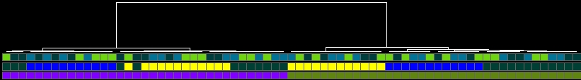
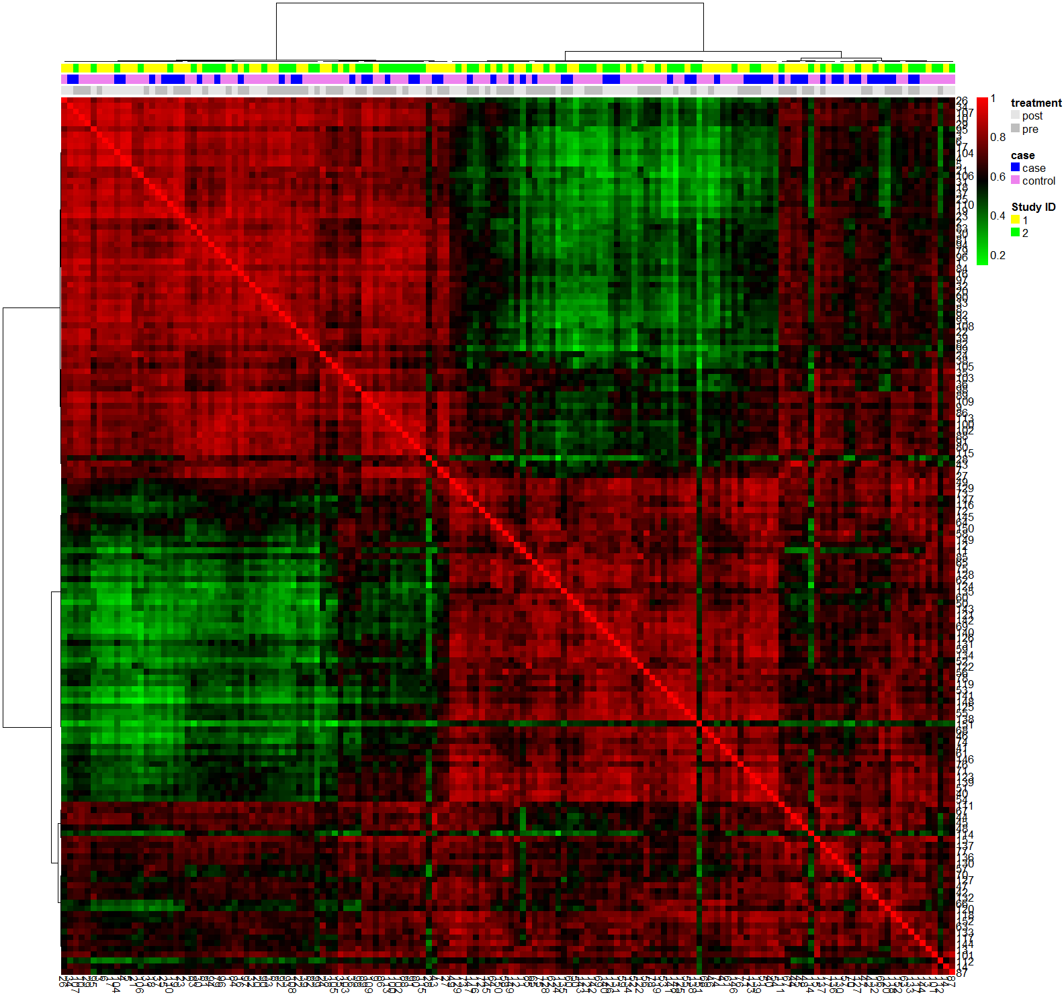
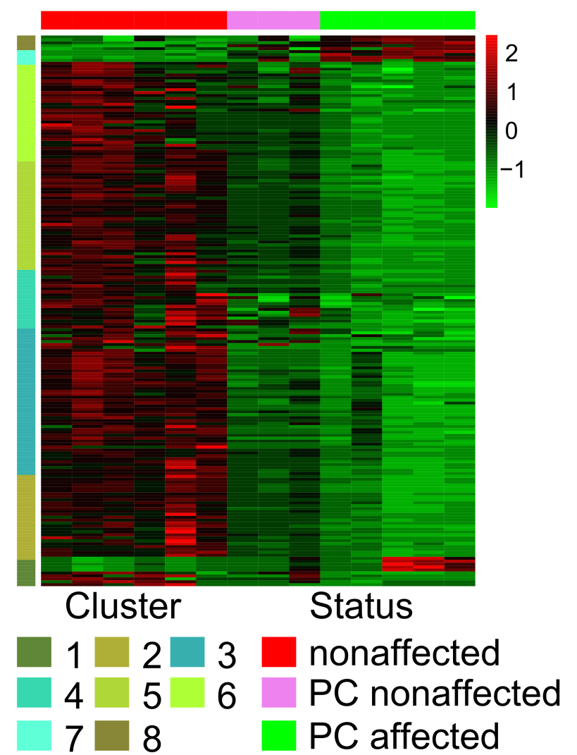
HCA interpretation
How does my metadata* match my data structure?
overview
confirmation
*
*
*

Slide 21
Your turn
Follow along with the following tutorial:
https://creativedatasolutions.github.io/CDS.courses/courses/network_mapping_101/docs/partial/clustering/#heirarchical-clustering

Slide 22
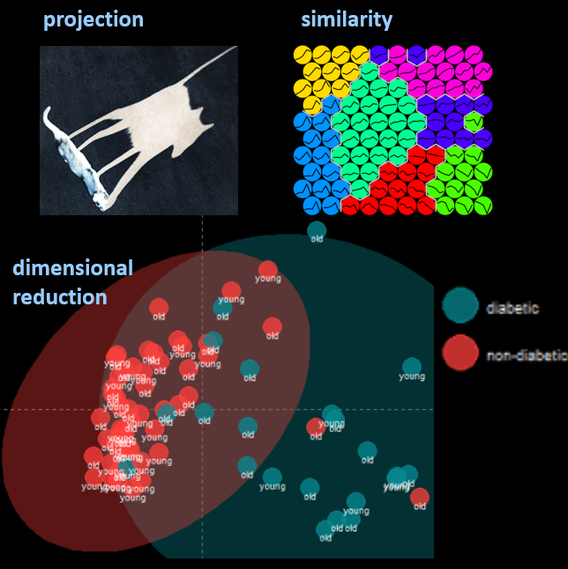
Principal Components Analysis (PCA)
reduce
dimensionality
maximize
variance explained
visualize
variance explained
outliers
sample scores
variable loadings
https://creativedatasolutions.github.io/CDS.courses/courses/network_mapping_101/docs/partial/multivariate/#pca

Slide 23
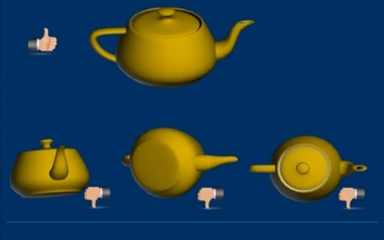
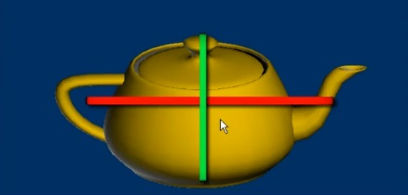
PCA goals
Principal Components (PCs)
non-supervised
projection of the data which maximize variance explained
results
eigenvalues = variance explained
scores = new coordinates for samples (rows)
loadings = linear combination of original variables
James X. Li, 2009, VisuMap Tech.

Slide 24
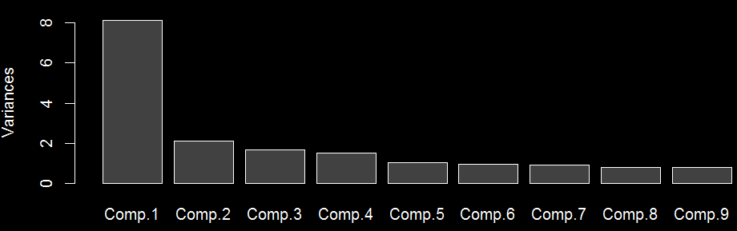
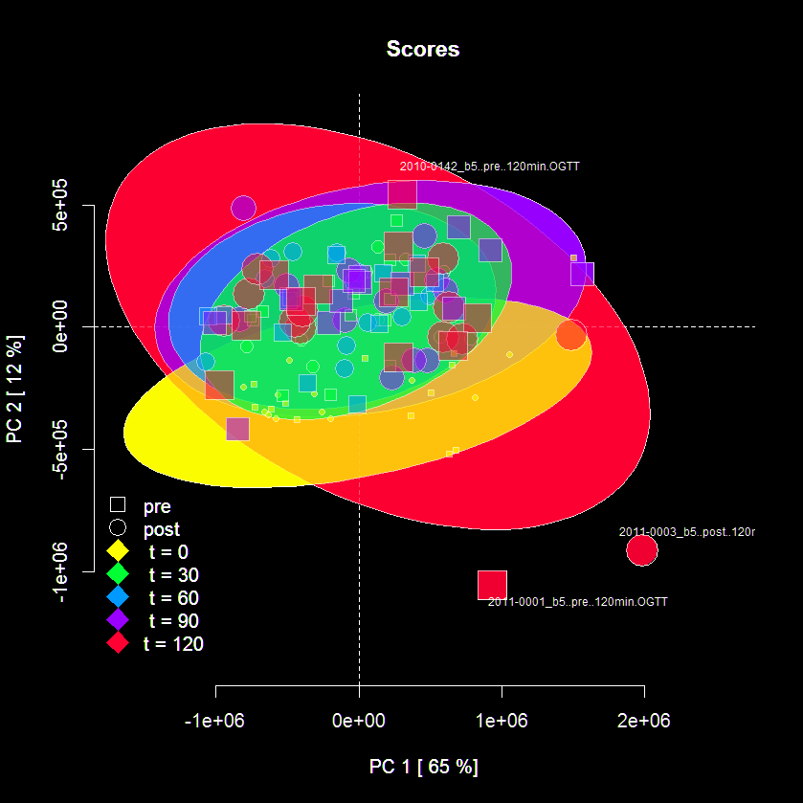
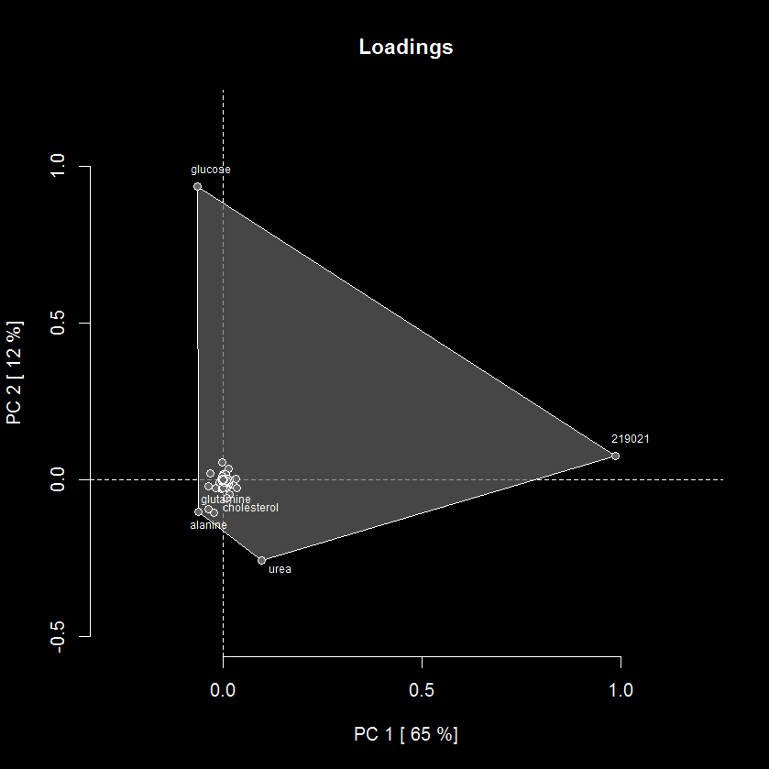
PCA interpretation
Variance explained (eigenvalues) Row (sample) scores and column (variable) loadings

Slide 25

PCA example
glucose
219021
*no scaling or centering

Slide 26
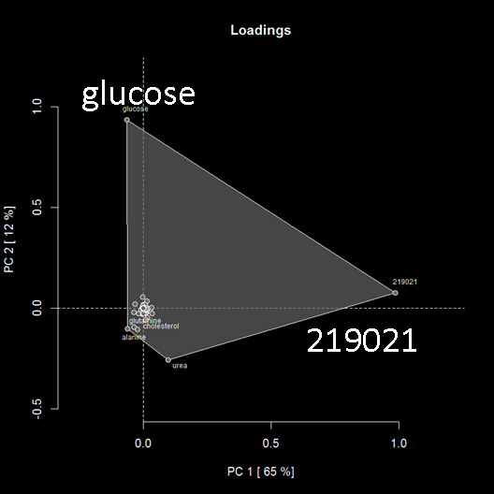
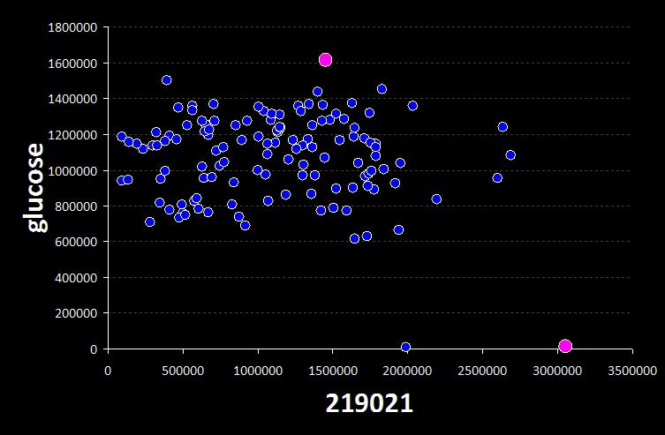
Relationship between
scores and loadings
loadings
top loading variable’s scatterplot
scores

Slide 27
Your turn
Follow along with the following tutorial:
https://creativedatasolutions.github.io/CDS.courses/courses/network_mapping_101/docs/partial/multivariate/#pca

Slide 28
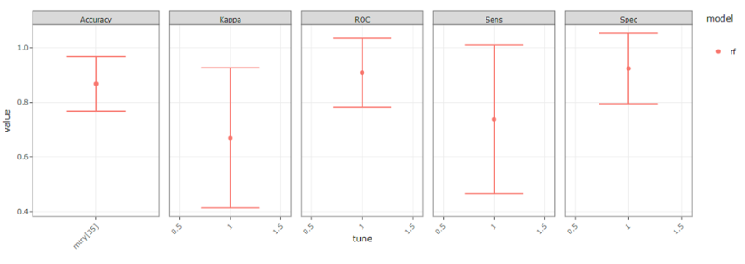
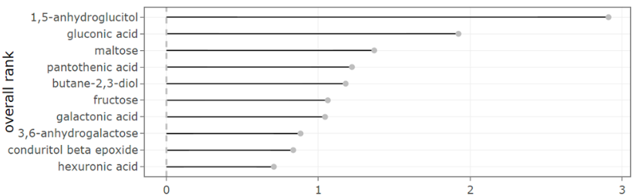
Machine learning
predict
sample classification
optimize
model performance
select
important features
visualize
model performance
feature importance
https://creativedatasolutions.github.io/CDS.courses/courses/network_mapping_101/docs/partial/model/

Slide 29
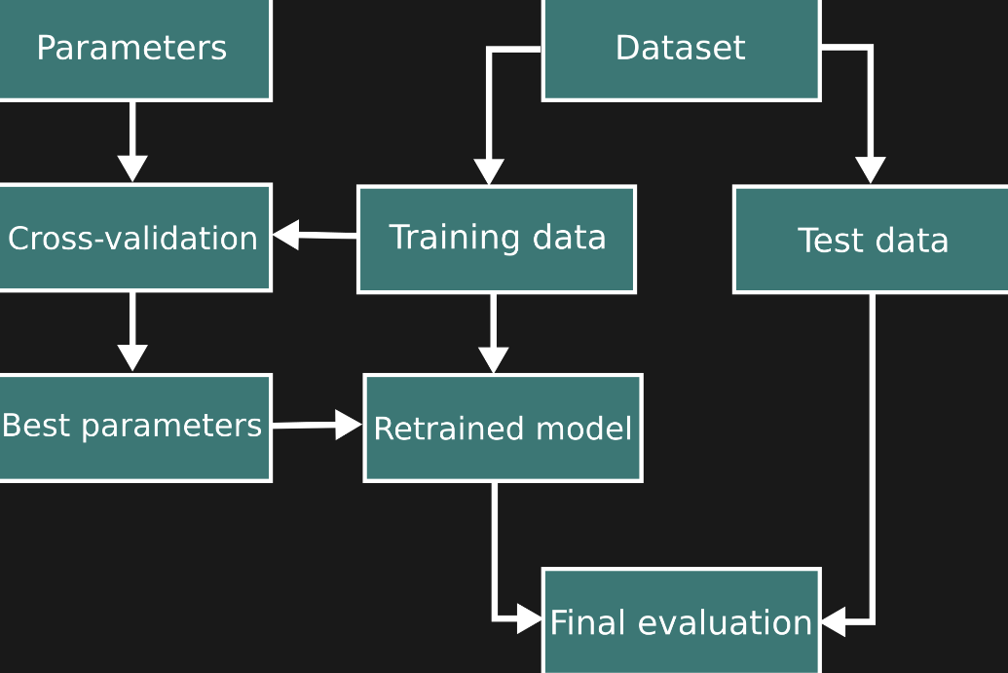
Machine learning
model validation
https://scikit-learn.org/stable/modules/cross_validation.html

Slide 30
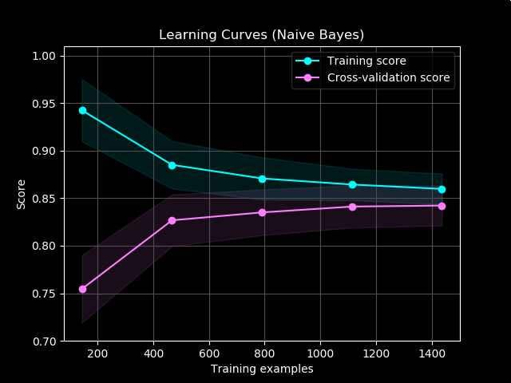
Machine learning
model training and validation
https://en.wikipedia.org/wiki/Learning_curve_(machine_learning)

Slide 31
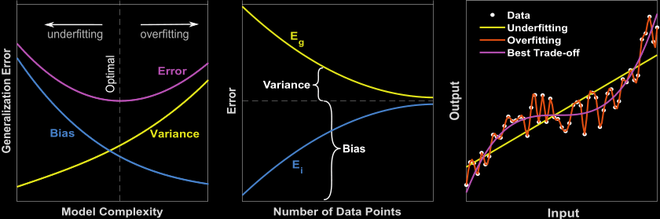
Machine learning
bias vs. variance
https://www.researchgate.net/publication/359896672_A_Review_of_Machine_Learning_Methods_Applied_to_Structural_Dynamics_and_Vibroacoustic/figures?lo=1

Slide 32
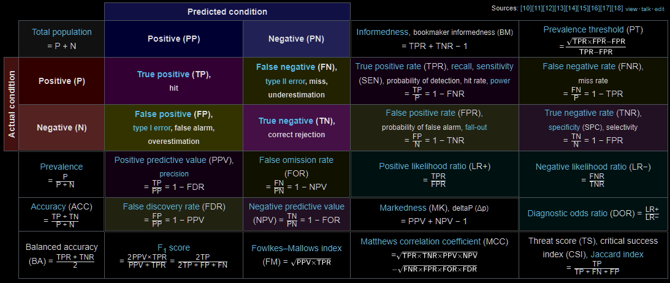
Machine learning
classification performance
https://en.wikipedia.org/wiki/Evaluation_of_binary_classifiers

Slide 33
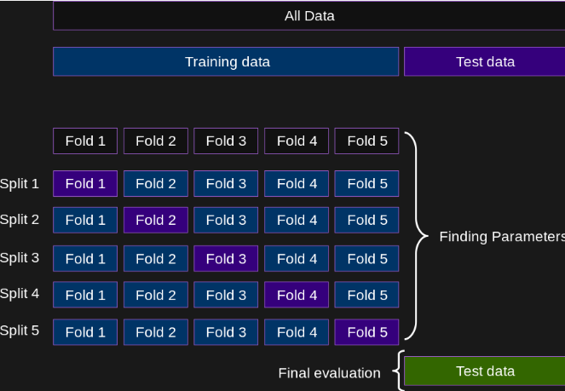
Machine learning
cross-validation
https://scikit-learn.org/stable/modules/cross_validation.html

Slide 34
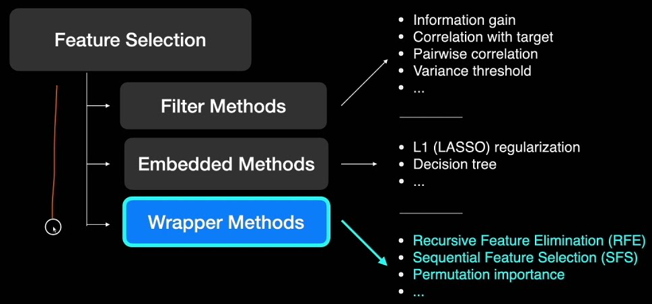
Machine learning
feature selection
https://scikit-learn.org/stable/modules/feature_selection.html#feature-selection

Slide 35
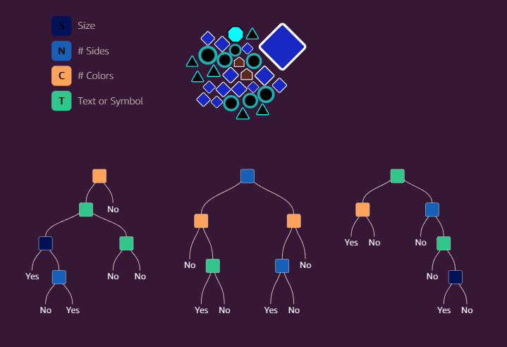
Machine learning
Random Forest
cross-validation
feature selection
https://mlu-explain.github.io/random-forest/

Slide 36

Machine learning
Random Forest
decision path
https://github.com/parrt/dtreeviz

Slide 37

Machine learning
Random Forest
decision path
https://github.com/parrt/dtreeviz

Slide 38

Machine learning
autoML
https://pycaret.gitbook.io/docs/get-started/quickstart?q=leaderboard

Slide 39
Your turn
Follow along with the following tutorial:
https://creativedatasolutions.github.io/CDS.courses/courses/network_mapping_101/docs/partial/model/

Slide 40

Network analysis
network mapping
transform variables
network calculation
regularized correlation
biochemical
structural similarity
model performance
visualize
interactive networks
https://creativedatasolutions.github.io/CDS.courses/courses/network_mapping_101/docs/partial/network/

Slide 41


Components for network mapping
connections (edges)
empirical dependency (correlation)
biochemical (substrate/product)
chemical similarity
…
nodes (vertices)
magnitude
importance
direction
relationships
…

Slide 42

Network data structures
adjacency matrix
https://www.steveclarkapps.com/graphs/

Slide 43

Network data structures
adjacency list
https://www.steveclarkapps.com/graphs/

Slide 44

Network data structures
edge list and
vertices list
(node attributes)
index
…
source
target
…

Slide 45



Correlation networks
Connect molecules based on strength of their correlation or partial-correlation
bivariate
multivariate
network

Slide 46

Correlation example
regularized correlation network showing relationships in metabolic timeseries measurements for two classes of samples

Slide 47





Biochemical networks
nodes
edges

Slide 48

Multi-Omic networks
https://www.ebi.ac.uk/training/online/courses/network-analysis-of-protein-interaction-data-an-introduction/types-of-biological-networks/

Slide 49

Multi-Omic networks

Slide 50

Multi-Omic networks

Slide 51

Structural similarity networks
Use structure to generate molecular fingerprint
Calculate similarities between metabolites based on fingerprint
BMC Bioinformatics 2012, 13:99 doi:10.1186/1471-2105-13-99

Slide 52

Structural similarity example

Slide 53


Treatment Effects Network
Combining
networks
Metabolites
Shape = increase/decrease Size = importance (loading) Color = correlation
Connections
violet = Biochemical relationships
green = Structural similarity
https://dgrapov.github.io/MetaMapR/gallery.html

Slide 54
Your turn
Follow along with the following tutorial:
https://creativedatasolutions.github.io/CDS.courses/courses/network_mapping_101/docs/partial/network/

Slide 55

Network refinement and visualization
learn
Cytoscape basics
map variables to
node attributes
edge attributes
optimize
layout
legend
publication quality figure
https://creativedatasolutions.github.io/CDS.courses/courses/network_mapping_101/docs/partial/cytoscape/

Slide 56
Your turn
Follow along with the following tutorial:
https://creativedatasolutions.github.io/CDS.courses/courses/network_mapping_101/docs/partial/cytoscape/

